Slide 1
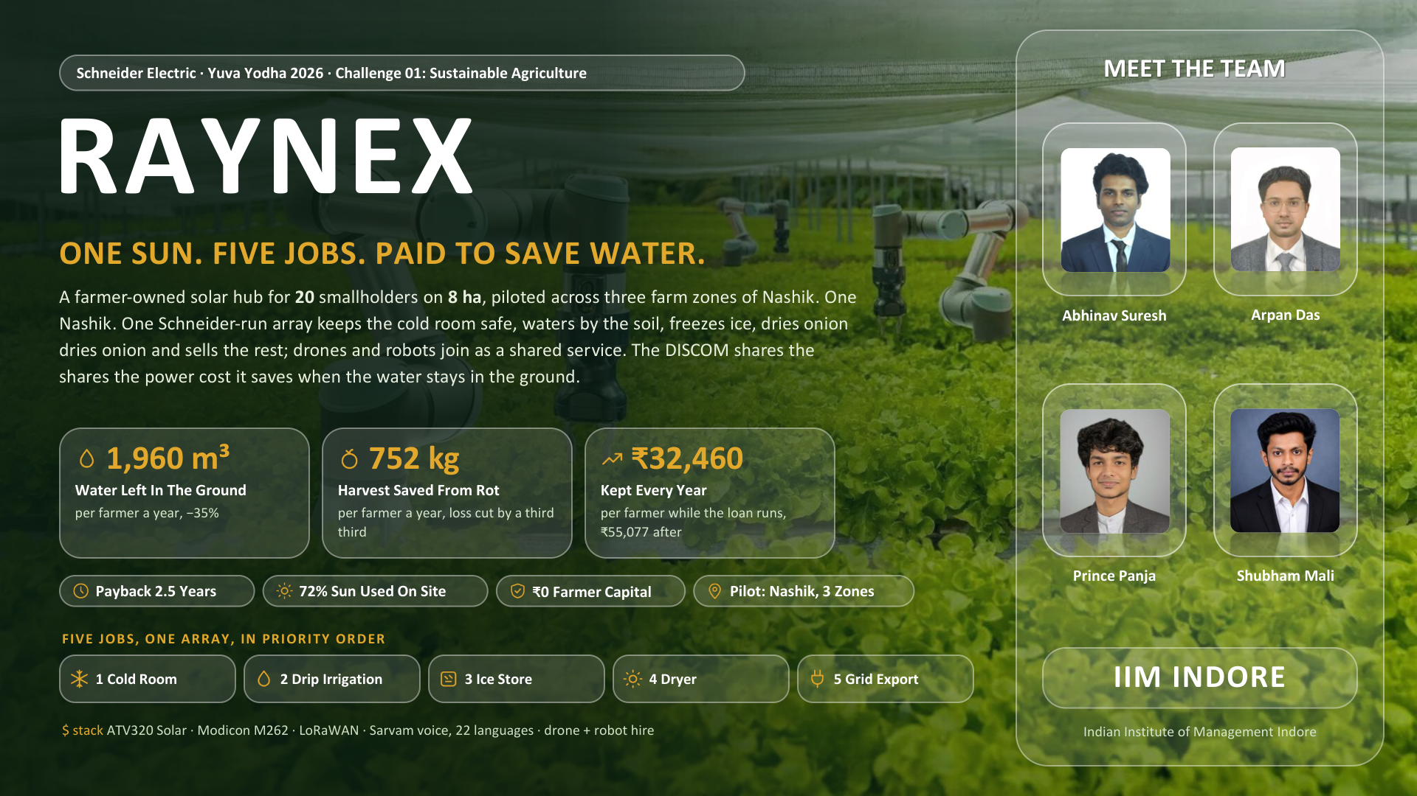

Slide 2
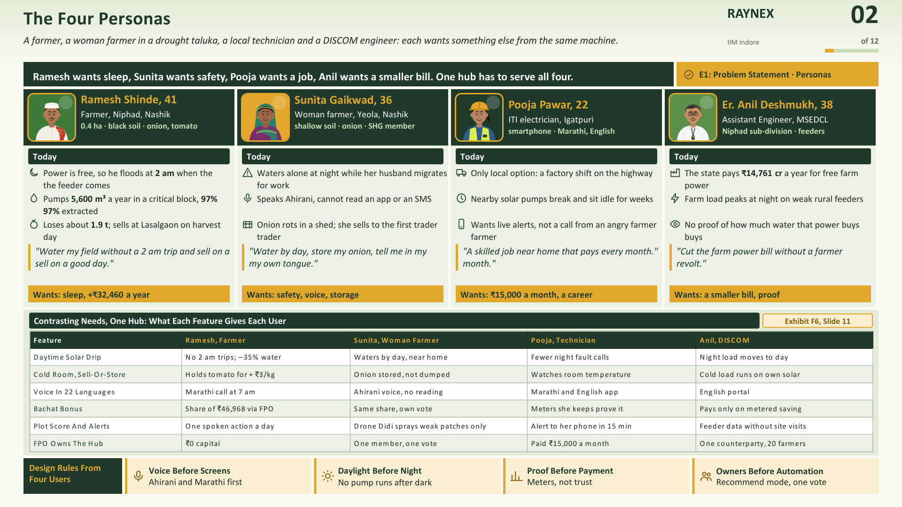

Slide 3
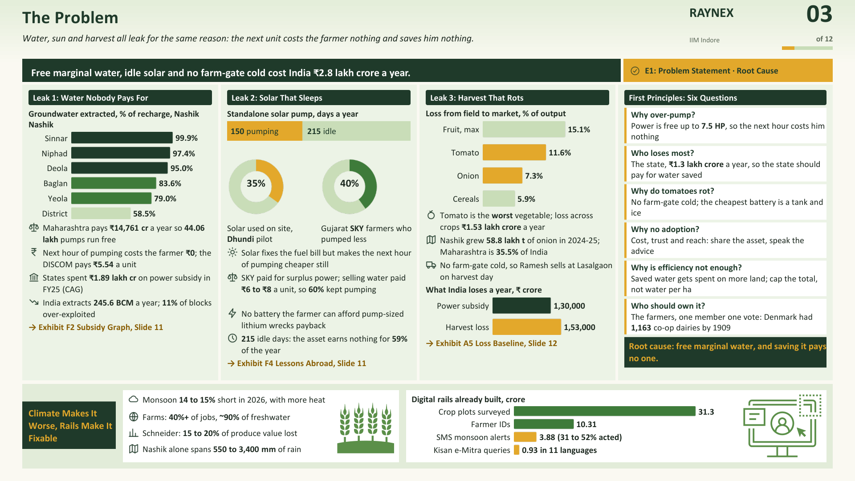

Slide 4
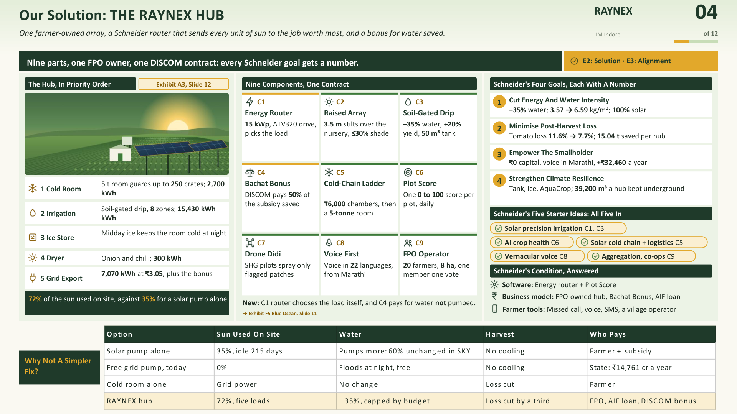

Slide 5
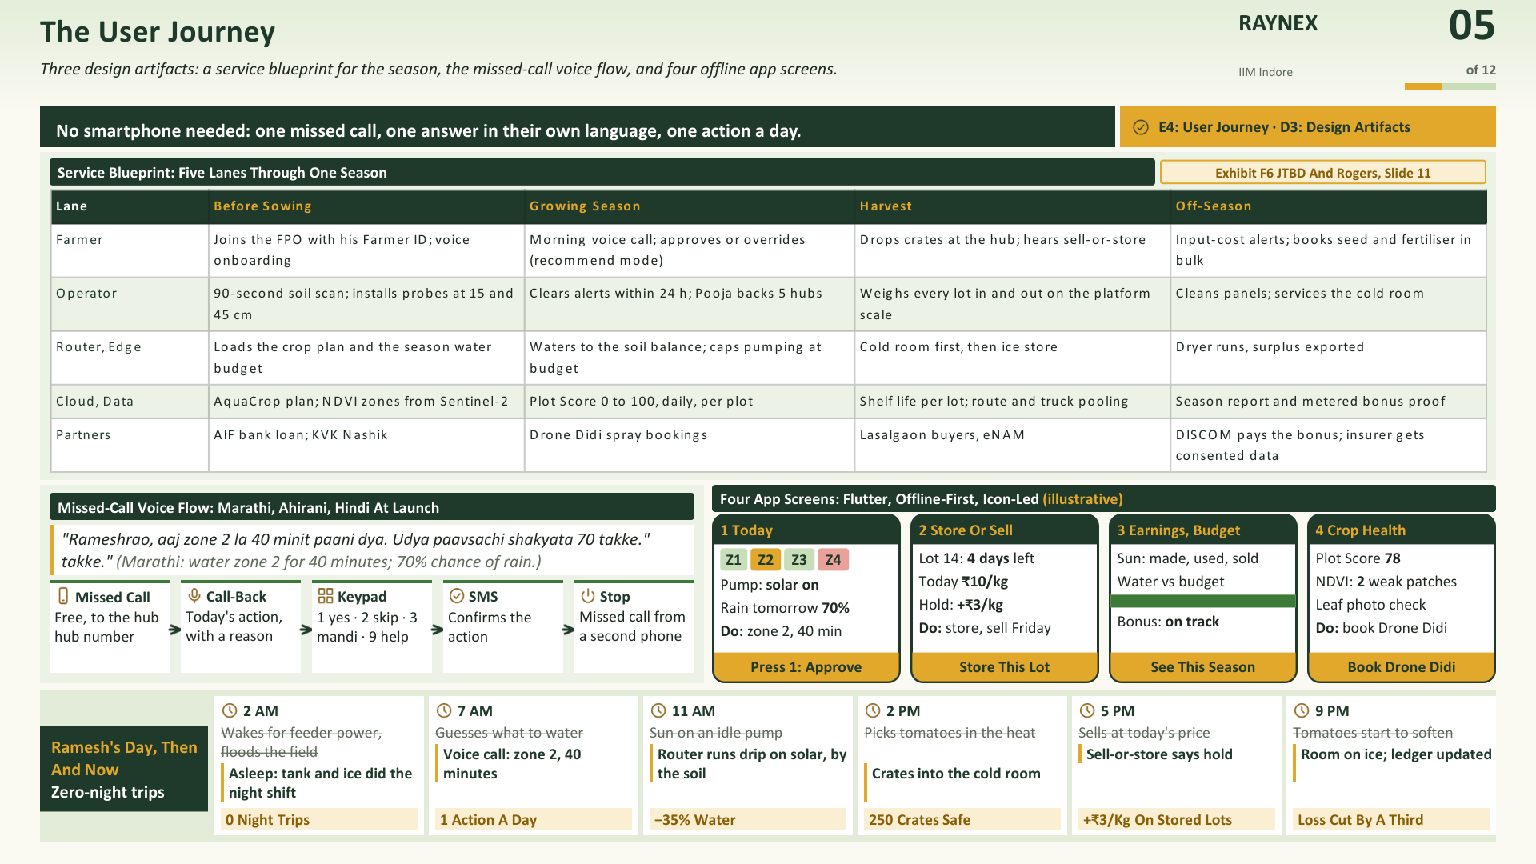

Slide 6
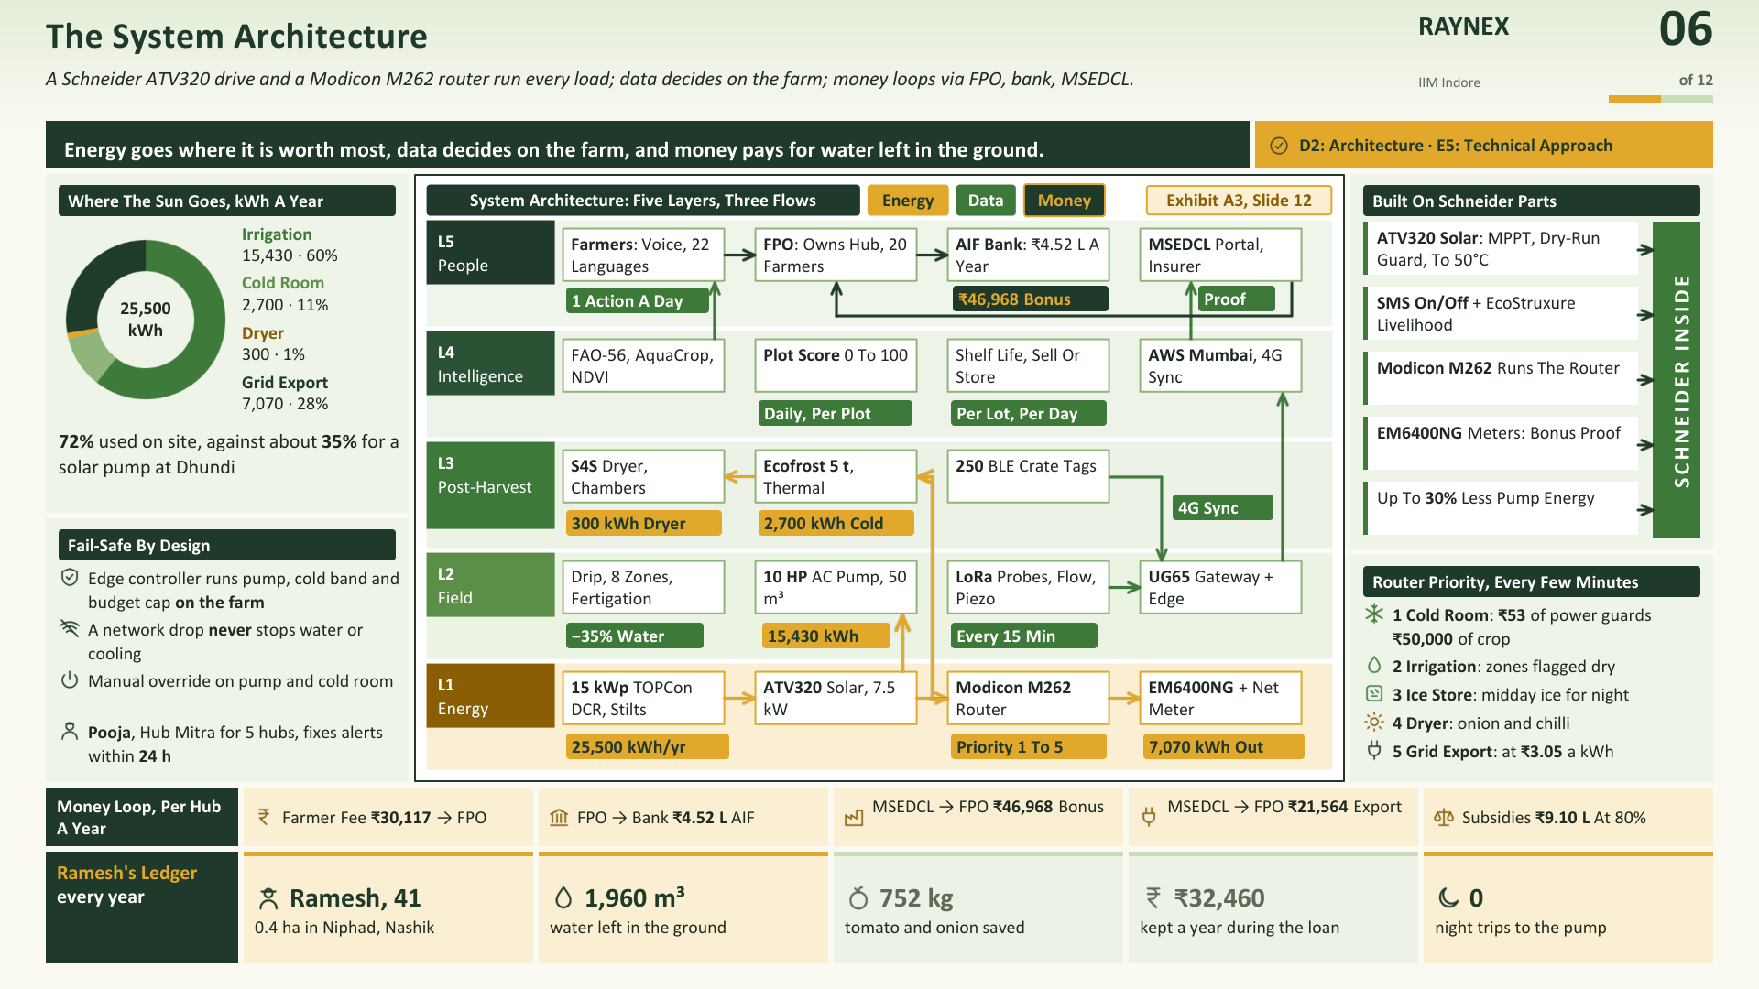

Slide 7
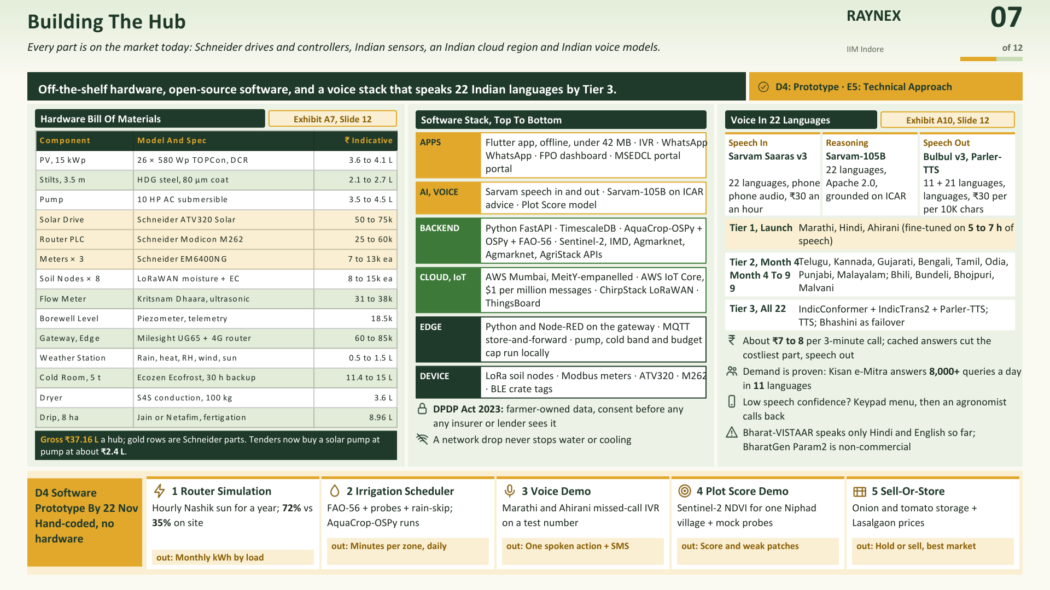

Slide 8
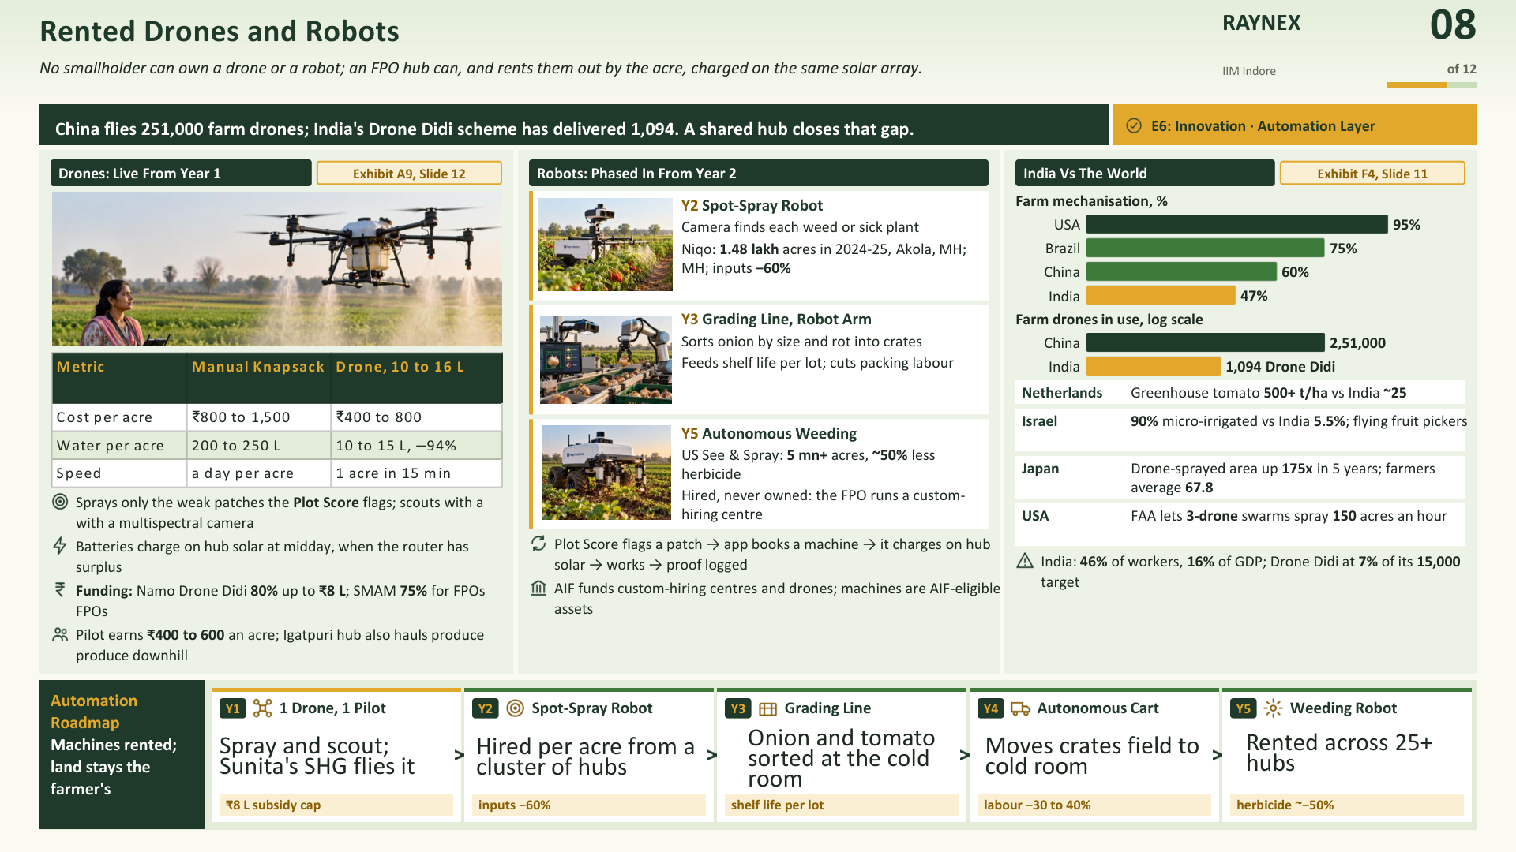

Slide 9
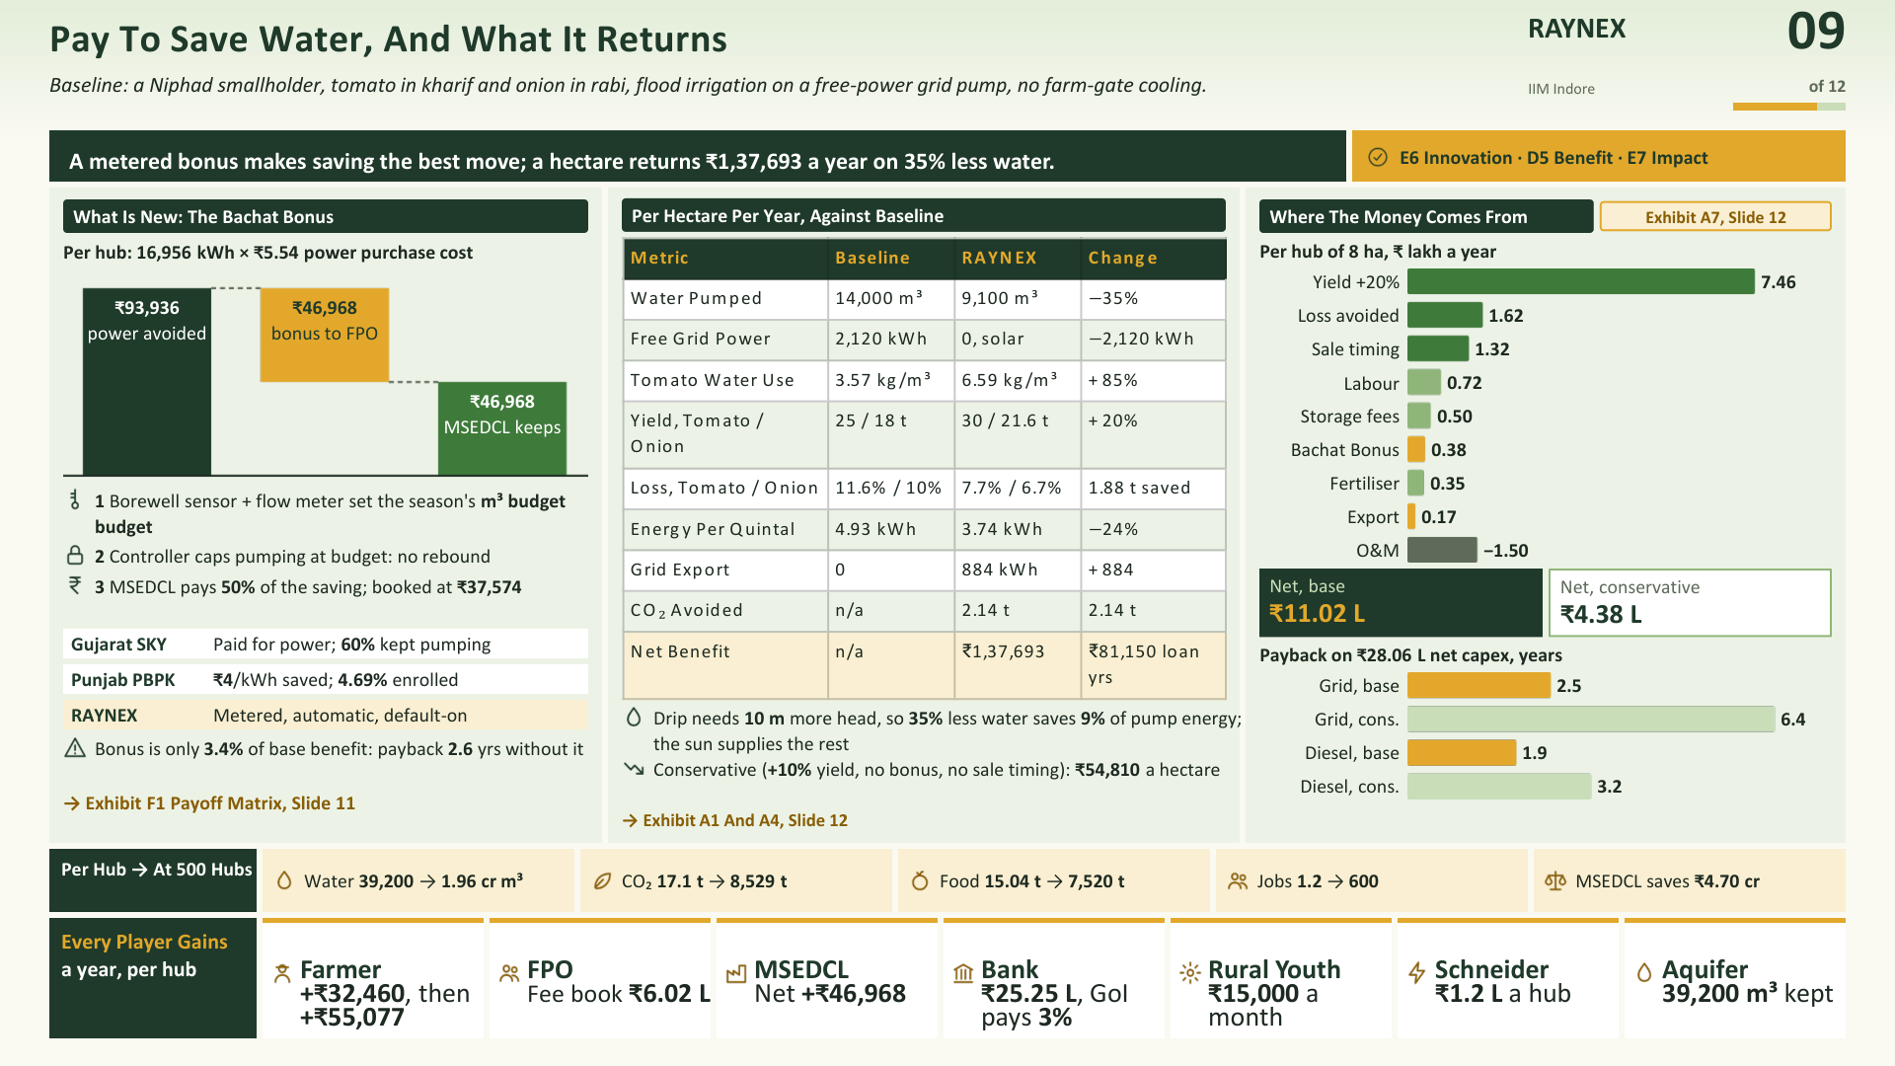

Slide 10
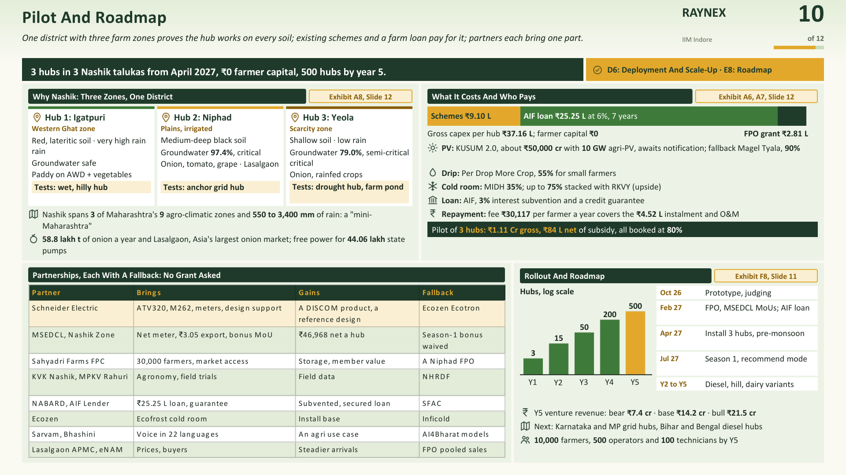

Slide 11
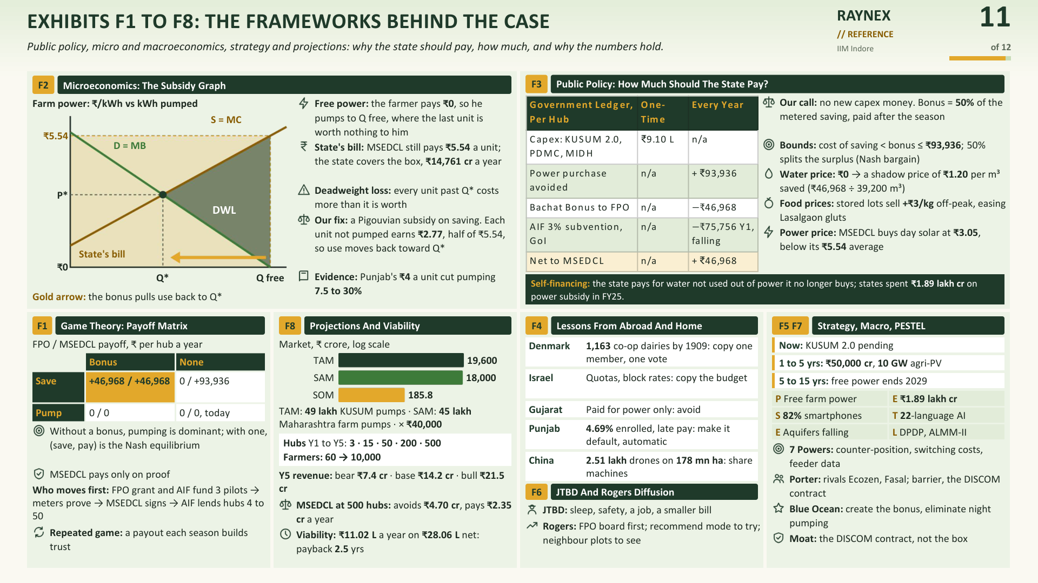

Slide 12
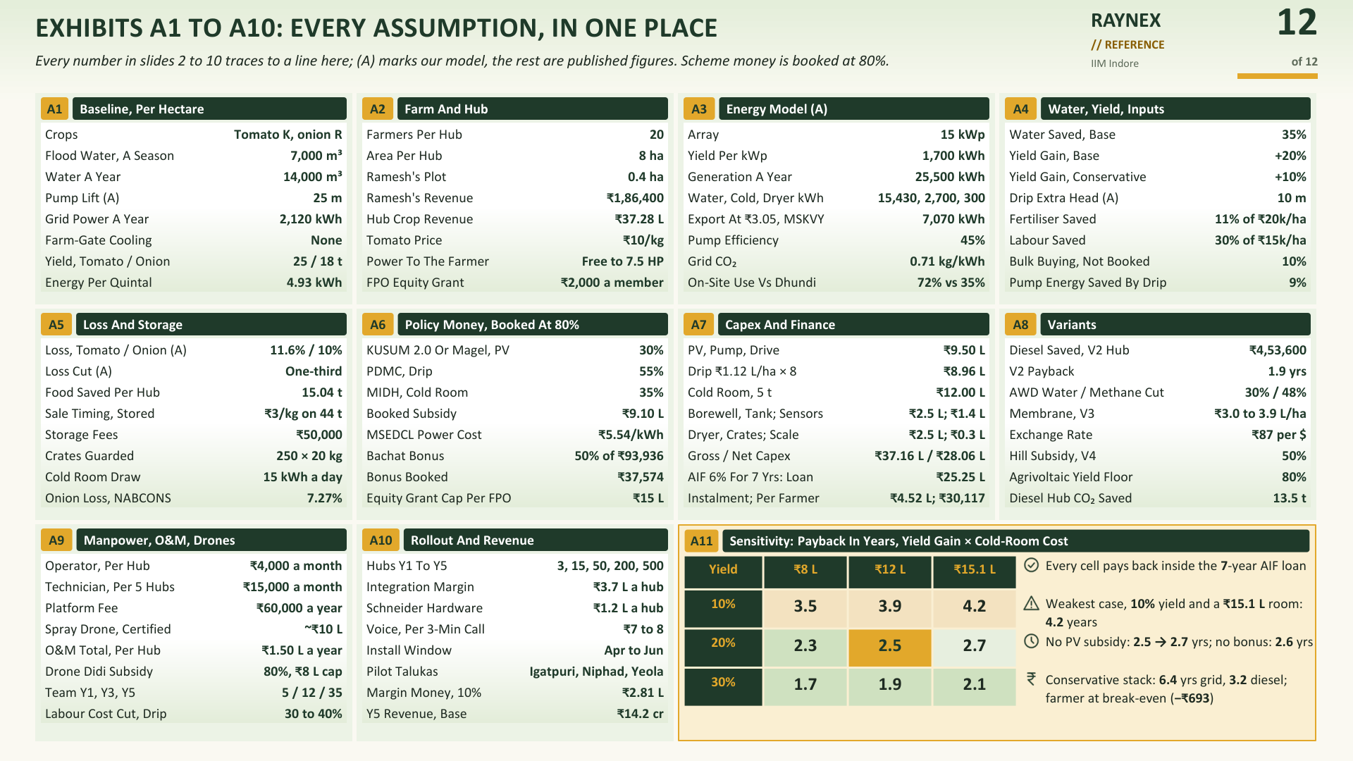

Slide 13
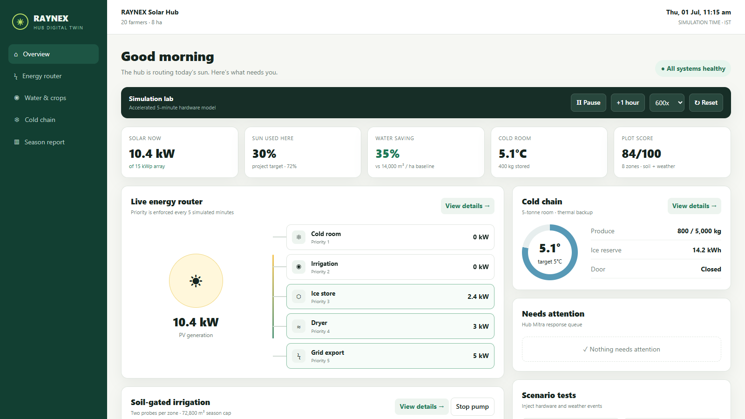
Simulation Lab: Prove The Router Before The Hardware
RAYNEX
13
A five-minute digital twin turns the architecture into a testable operating system.
of 13
One screen validates energy priority, water logic, cold safety and farmer decisions.
D4: Prototype · E5: Technical Approach
WHAT IT MODELS
15 kWp array · weather-shaped PV output
Five jobs · cold → water → ice → dryer → grid
Physical state · 8 zones, probes, pump, 5 t room
HOW TO TEST
Time · 1×, 60×, 600× or 3000×
Faults · cloud, heat, outage, probe, open door
People · approve, skip or stop the pump
WHAT IT PROVES
Priority · critical cold load always comes first
Safety · daylight water + ice-backed cooling
Evidence · exact kWh ledger and run report
LIVE FASTAPI + WEBSOCKET UI
D4 SOFTWARE
PROTOTYPE
1
INJECT
2
OBSERVE
3
DECIDE
4
VERIFY
Change weather or break a sensor
Watch power, soil and cold state
Approve or override the action
Export evidence against targets
Before hardware

